Slide 1
ANALYSING SALARY PATTERNS IN POWER BI
Student details:
Yarrabathina Jahnavi
111422243111
AI&DS /3rd YEAR/B
Company details:
RETECH SOLUTIONS PRIVATE LTD
Website:
https://www.retech.com

Slide 2
Weekly Report
Week 1: | Descriptive analysis
Week 2: | Demographic analysis
Week 3: | Performance based analysis
Week 4: | Predictive and prescriptive analysis

Slide 3
PROBLEM STATEMENT
To identify, analyze, and visualize salary patterns across various dimensions to better understand compensation trends and disparities. This analysis aims to provide insights into how salaries are distributed across departments, job levels, experience, locations, and demographic factors. The ultimate goal is to support data-driven decision-making for human resources, compensation planning, and strategic workforce management.

Slide 4
ABSTRACT
Objectives:
1.Identify trends and disparities in compensation
2. Optimize salary structures for fairness and competitiveness
3. Inform budgeting and forecasting decision
4. Enhance employee satisfaction and retention
5. Ensure compliance with regulations
METHODLOGY :
1: Data Collection and Preparation 2: Data Modeling
3: Visualization
4: Analysis
5: Insights and Recommendations 6: Sharing and Collaboration

Slide 5
MODULE
1.Salary Distribution
Visualizations:
- Histogram
- Box plot
- Scatter plot
Metrics:
- Average salary
- Median salary
- Salary range
- Standard deviation
2. Salary by Department/Role
Visualizations:
- Bar chart
- Column chart
- Treemap
Metrics:
- Average salary by department
- Average salary by role
- Salary range by department
3. Salary by Demographics
Visualizations:
- Bar chart
- Column chart
- Heatmap
- Metrics:
- Average salary by gender
- Average salary by age group
- Salary range by ethnicity
4. Salary Growth and Trends
Visualizations:
- Line chart
- Area chart
- Scatter plot
- Metrics:
- Salary growth rate
- Average salary increase

Slide 6
IMPLEMENTATION
Connect to your data source: Connect Power BI to your data source, such as an Excel spreadsheet, SQL database, or HR system, where salary data is stored.
Create a data model: Create a data model that includes tables for employee information, salary data, and any other relevant data, such as department, location, or job title.
Visualize salary patterns: Use Power BI's visualization tools to create reports and dashboards that showcase salary patterns, such as: - Salary distribution by department or job title - Average salary by location or level - Salary growth over time - Comparison of salary ranges across different groups
Use DAX formulas: Use Power BI's DAX (Data Analysis Expressions) formulas to create calculations and measures that help analyze salary patterns.

Slide 7
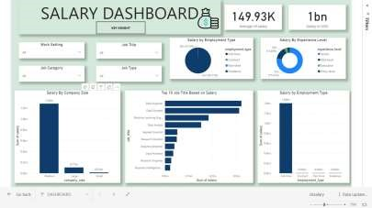
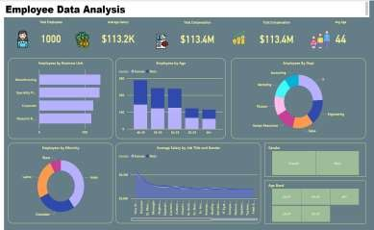
OUTPUT

Slide 8
RESULT
Overall Trend: Salaries show a steady growth pattern over time, with notable peaks during specific periods.Department-Wise: Departments like Engineering and IT generally have higher average salaries, indicating a skills premium.Experience Correlation: Salaries increase with experience, typically plateauing after a certain level.Geographic Distribution: Major cities or specific regions show higher salaries, often reflecting the cost of living.Top Earners: Mostly high-level roles or specialized positions, revealing the value placed on specific skills and leadership.

Slide 9
conclusion
The salary analysis in Power BI reveals clear patterns and insights. Salaries generally increase over time, particularly in high-demand departments like Engineering and IT, indicating a premium on technical expertise. While experience positively correlates with salary, earnings tend to plateau after a certain experience level, suggesting a cap based on role or market standards. Geographic analysis shows higher pay in urban areas, likely due to higher living costs. The top earners are predominantly in senior or specialized roles, highlighting the company’s focus on rewarding leadership and niche skills. This analysis provides actionable insights for aligning compensation

Slide 10
Thank you

